Slide 1
Phonics and early reading at Senacre Wood

Slide 2
At Senacre Wood, we follow the Read Write Inc phonics and Get Writing program
The Read Write Inc phonics program is a systematic synthetic phonics program.
The program has been approved by the Department for Education

Slide 3
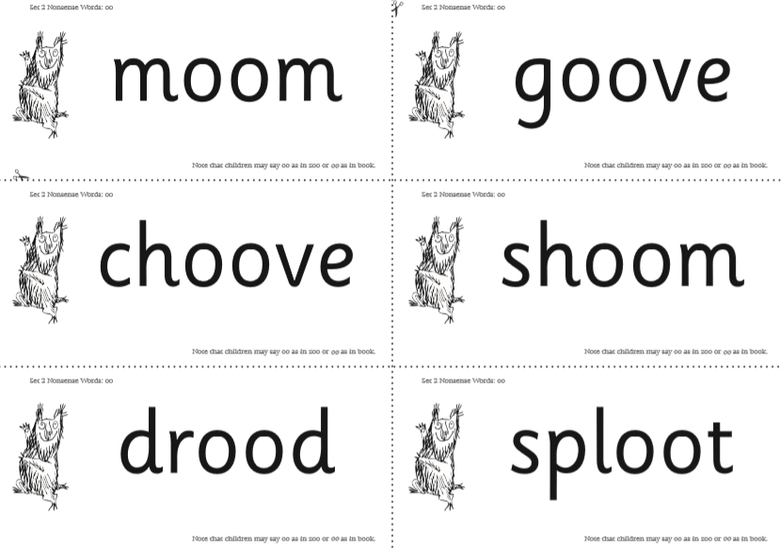
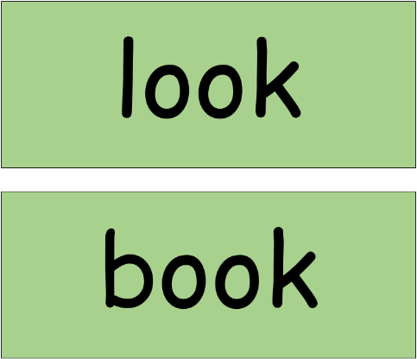
What does phonics look like for your children?
The children are taught new sounds in the RWI specified order in their Speed sounds lesson.
Within this lesson they will learn this sound first orally, then by sight and then within words and alien words

Slide 4
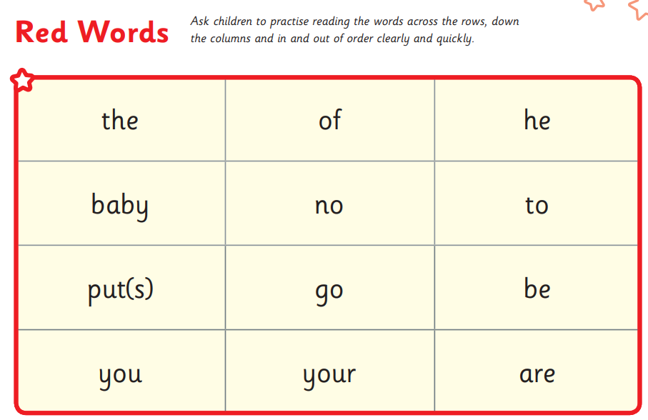
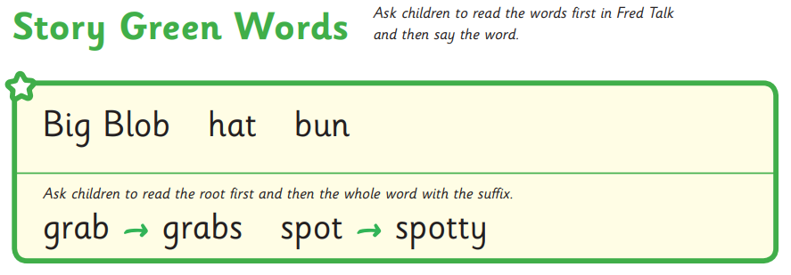
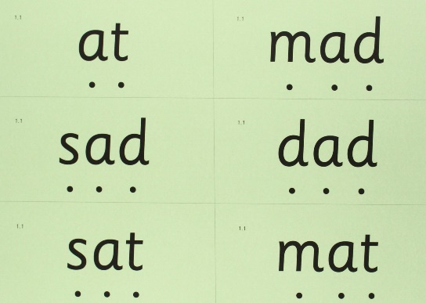
Green words and red words
The children read the story green words from the book they will be reading in class as a group, before reading within the story.
They will then read the speedy green words.
As a group, they will read the red words (words that are not phonetically decodable) before reading within the story.

Slide 5
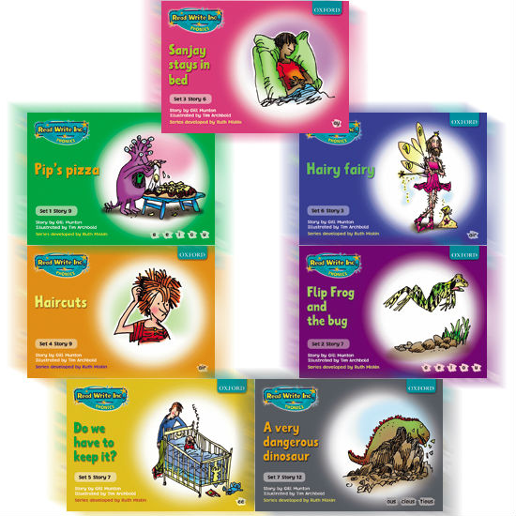
Reading with Read Write Inc
Children read their coloured story book with their partner, reading a page each
Their phonics teacher will move around the group, hearing the children read

Slide 6
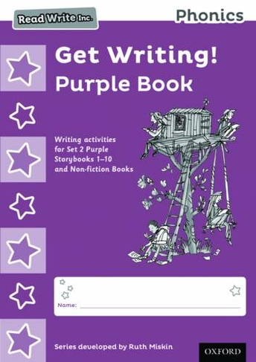
RWI Get Writing
Children in Year 1 complete activities within the RWI Get Writing books as their English lesson every morning. With their Phonics teacher

Slide 7
Reading and Phonics assessment
The children are assessed using the RWI assessments each half term. This determines which coloured group will best suit their abilities the following term
We complete Phonics Screening Check mock tests each half term to assess to children’s progress

Slide 8
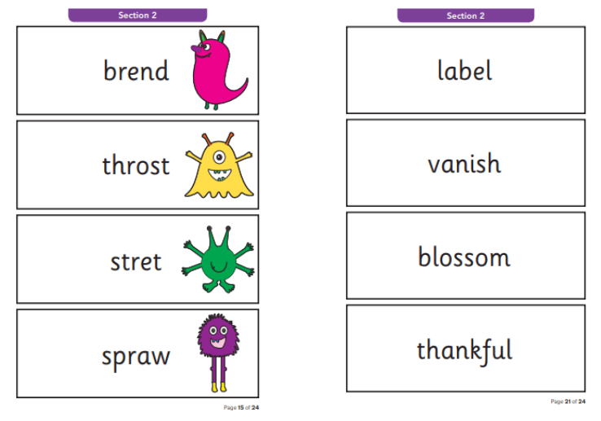
The Phonics Screening Check
This is National test that takes place for all year 1 children across the country each June.
Historically, the children will need to obtain a score of 32/40 to pass the check
The check is made up of 40 words to test the children’s phonic knowledge. 20 real words and 20 nonsense/alien words
I will hold a meeting specifically for the PSC nearer the time

Slide 9
Reading at home

Slide 10
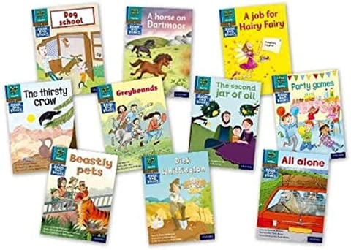
Why read at home?
Reading at home helps the children to consolidate the knowledge that they gain when in school
It gives you, as a parent, a clear understanding of how your child is getting on with their reading
Reading or being read to increases the amount of vocabulary
Reading with your child gives them special, uninterrupted time with you where they can build their confidence
Notes:
Add in class teacher and TA

Slide 11
‘Reading is the best way for your child to grow their vocabulary because books are troves of knowledge with unique language that describes the world around us.’(Scholastic.com)

Slide 12
Reading at home
The children will be given a new RWI Book Bag Book every Monday, this will be written in their reading records.
They will keep this book ALL WEEK. It is vitally important that children reread texts to improve their fluency and confidence.
They DO NOT need to read the whole book every night, a page or two is fine
Every Friday, they will visit the library where they will choose a special library book to keep until the following Friday. This is a book for them to love and treasure and read for pleasure.
The children that are noticed for making the most effort to read at home this term will be in with a chance to take home Rosie the reading bear and two hot chocolate sachets over the weekend.

Slide 13
A few tips and tricks to take away with you:

Slide 14
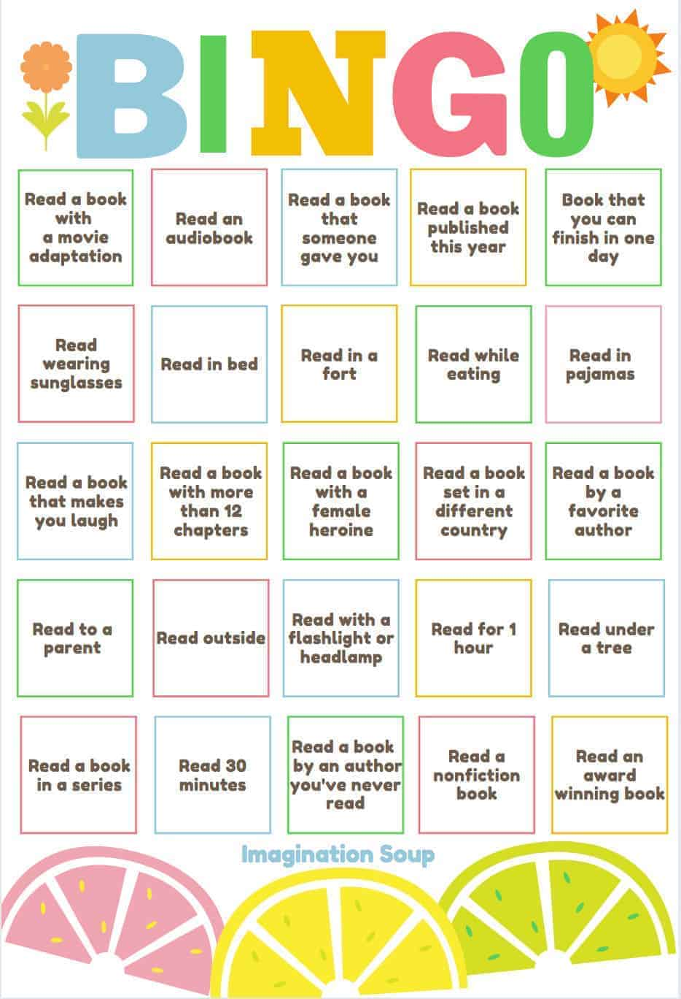

Slide 15
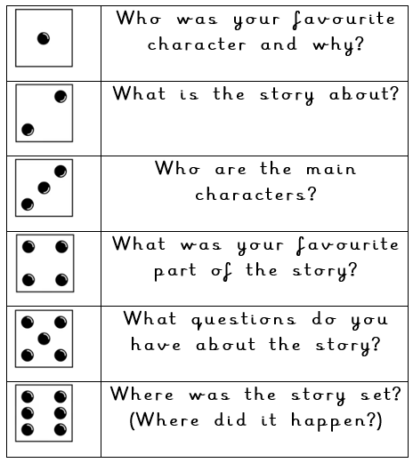

Slide 16
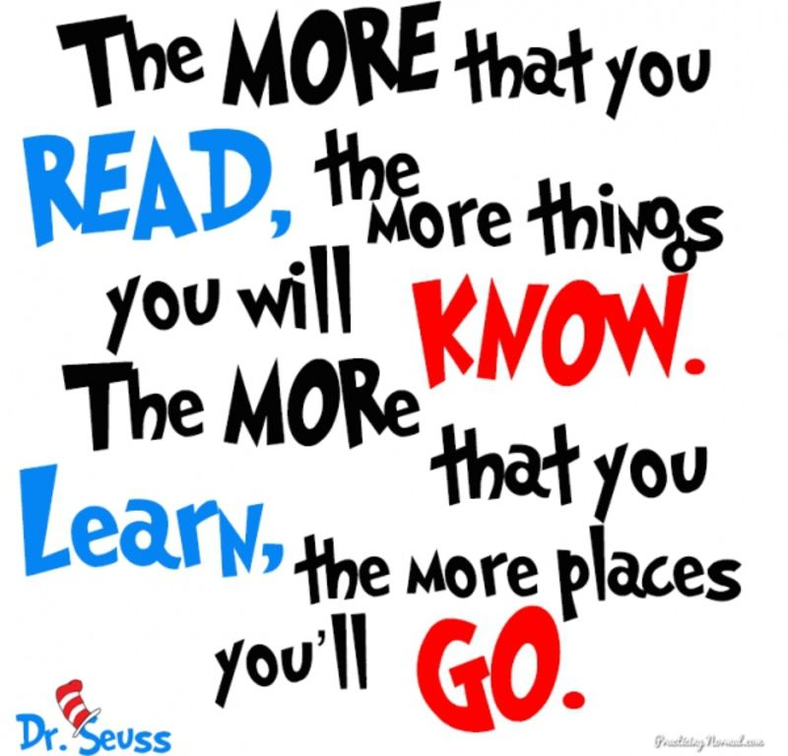

Slide 17
Let’s bring in the experts…the children

